Slide 1
Group G
WEEK 11
Ryan Klugman
Bowei Liu
Isabel Barlow

Slide 2
Progress
Ryan:
Sine wave player
Music creator webapp
Bowei:
DEPP communication
Ultrasound sensing
Isabel:
Ultrasound sensing
Notes:
So, I’ll start off with a quick overview of what our team members have been working on. I spent most of the past few weeks refining the music playback, although I’ve since moved on to the webapp. Bowei has been hard at work on the DEPP component, and has also started looking at ultrasound sensing, which Isabel has working with over the past week as well.

Slide 3
Progress: Music Playback
Redesigned entire module
Experimented with different types of waves
Converted 2D sine table into 1 long array
Made sure sine table was inferred as Block RAM instead of LUTs
Resolved popping issues
Analysed waveform with ModelSim
Implemented note player as finite state machine
Notes:
So if you remember last presentation I spoke about having redesigned the entire music module. Well over the midsem break I did that again… five more times. Basically I wasn’t happy with the way the sine wave was behaving so I did a lot experimentation with various implementations of square, sine, triangle and hybrid waves. For instance, I found that the triangle wave provided the best balance between volume and audio quality, and the was most elegant solution, however I wasn’t happy with the performance cost the divider that it used. Meanwhile, my initial design for the sine wave involved having a 2D array that had a separate sine values for each of the 12 notes, but I realised that since the inner arrays were all of different lengths and padded with extra 0s there was a lot of wasted space, so instead I concatenated it all into a single array and then used a separate array to index the initial positions.
My biggest hurdle with the sin wave was getting the sine table array to be inferred as Block RAM, since it was 2KB in size an implementing it as LUTs was taking to long to synthesize and map. The thing with block ram is that once you read the value you can’t do anything else with the result in the same clock cycle, not even add 1 to it. Every time I tried to redesign the code to meet these requirements I would get strange glitching or popping through the speaker. After spending hours in vain trying to debug by inspection, I concluded that the only way I was going to find the source of the problem was to analyse the waveform. I then wasted even more time trying to display the output on the oscilloscopes in the Lyre Lab, which was a complete waste of an afternoon since those oscilloscopes are useless.
I then had no other option but to resort to simulation so I downloaded ModelSim and set up a testbench. Thanks to that I was able to pinpoint the error and stop the popping, although I will say that ModelSim is not an ideal tool for analysing sound waves since you are bounded by real time. In Comp Arch it was fine because we only needed a few nanoseconds of simulation for our processors to complete, now we have to wait in the order of milliseconds before even getting a speaker pulse, and I would have to leave the simulation running for several minutes to get through the first second of the song. Luckily, that was enough for my cause.
So now I have I music player module that is super efficient, compiled with no warnings, and takes no more than 30 seconds to synthesize and generate on my machine.

Slide 4
Progress: Webapp
Built new website from scratch
Simple design
Intuitive to use
Embedded keyboard to create music files
Display input on musical staff
Using pure Javascript/HTML/CSS only
Notes:
So after finishing the music player, I started doing some work on the webapp, which was very behind schedule and hadn’t been touched since like week 5 or 6, and was more of collection of random test buttons and text fields than a site with any real functionality. So I built a new website from scratch, this time using pure Javascript, HTML and CSS only, so I didn’t have to deal with running a web server in the background. I wanted to create the simplest and most intuitive design possible, so I focused on what the core functionality of the website was supposed be: a user-friendly way to create music that was saved as the specified format. I decided that naturally if you’re gonna be writing music the best way to take user would be to embed a piano keyboard, while the best method of visual response would be to display the output on a staff. So what I made was this…

Slide 5
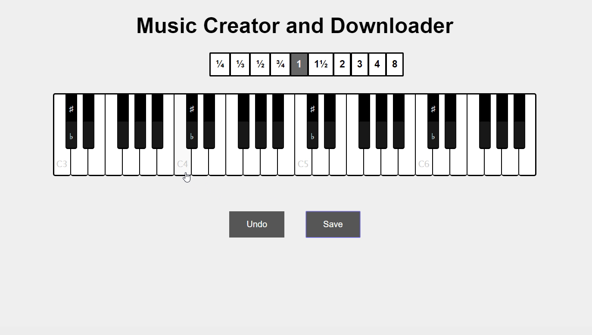
Notes:
…which I think is pretty cool. Now one of the problems I ran into was how to handle displaying tuplets, which are not supported by the API. And the reason for that is that “tuplets”, as they are called in the assignment, are not a real thing. The word tuplet in music actually refers to a group of several irrational notes, and there is no standard symbol for 1/3 of a crotchet because it literally doesn’t exist in music. So my workaround for this was just to display it as a dotted semiquaver, which is closest to its length and conveniently not required to be handled by our music player.
But yeah, “tuplets” are evil and are even more of a pain to handle on the hardware side, since they are the only note that is not a multiple of ¼ of a crotchet. If this project is run again I would highly recommend removing them form the spec for the sanity of any future students.
Obviously, there are still a few things missing such as the ability to set the starting tempo and a button to download your song to the FPGA, but these things should be fairly trivial to add. Also, currently the virtual keyboard doesn’t make any noise, and I feel it would be nice to have it play the respective note when you click on it.

Slide 6
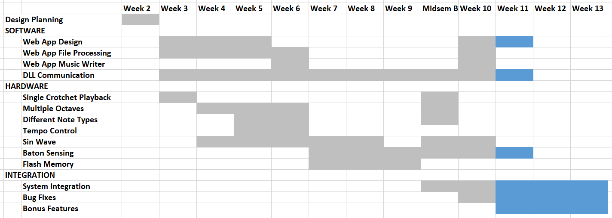
Gantt chart
Notes:
So on to the Gantt chart, as you can see, we have been working on a lot of aspects of the project over the past two weeks, including rewriting components that hadn’t been touched in weeks. So you can see here that there are many sections which are not continuous, such as the single crotchet playback. Looking forward the main thing left to do is to the baton sensing finalised and the subcomponents integrated together, other than that its just finishing touches.
Another thing that should speed up progress from this point is that we will no longer have to all fight over one speaker module, thanks to the magic of soldering jumper pins to some headphones which can then be plugged directly into the board. Would recommend doing that if having only one speaker is bottlenecking your group.

